Slide 1
Agile Communication
Project

Slide 2
Agile Communication
Project
Sprints 1-3

Slide 3
Sprints 1-3 Questions
What is your Velocity for the past 3 sprints?
Velocity for the past 3 sprints is :21
How do you know your Velocity is correct?
Velocity measures the amount of work a team can deliver during a sprint. It is calculated by summing up the points for all completed user stories at the end of sprint divided by the number of sprints.It determines the number of product backlog items to tackle during sprint planning.
What would the BURN DOWN chart look like for Sprints 1-3?
The chart on the Right
What would the BURN UP charts look like for Sprints 1-3?
The chart on the Right
How many points do you think the Team should commit to for Sprint 4 and justify your answer?
The team should commit 21 story points for sprint 4 because the velocity of the previous three sprints was 21.

Slide 4
Agile Communication
Project
Sprint 4

Slide 5
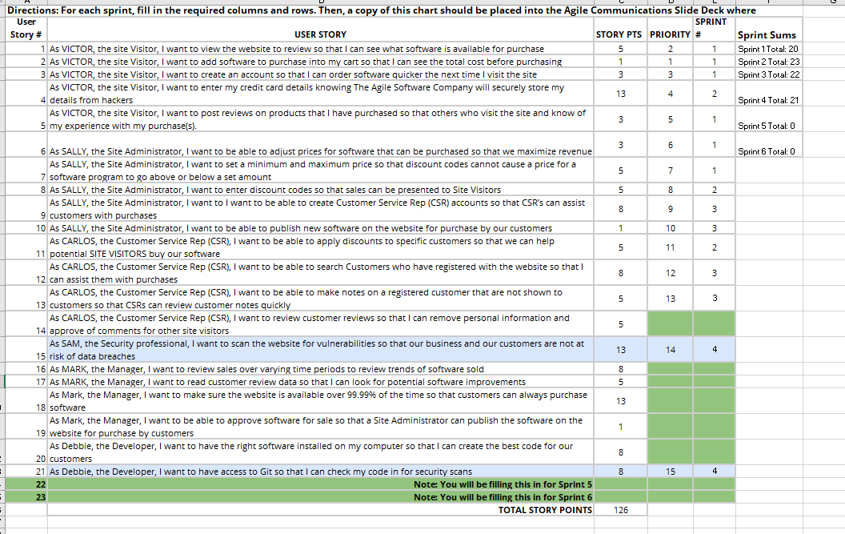
Place User Stories Table for Sprint 4 Here

Slide 6
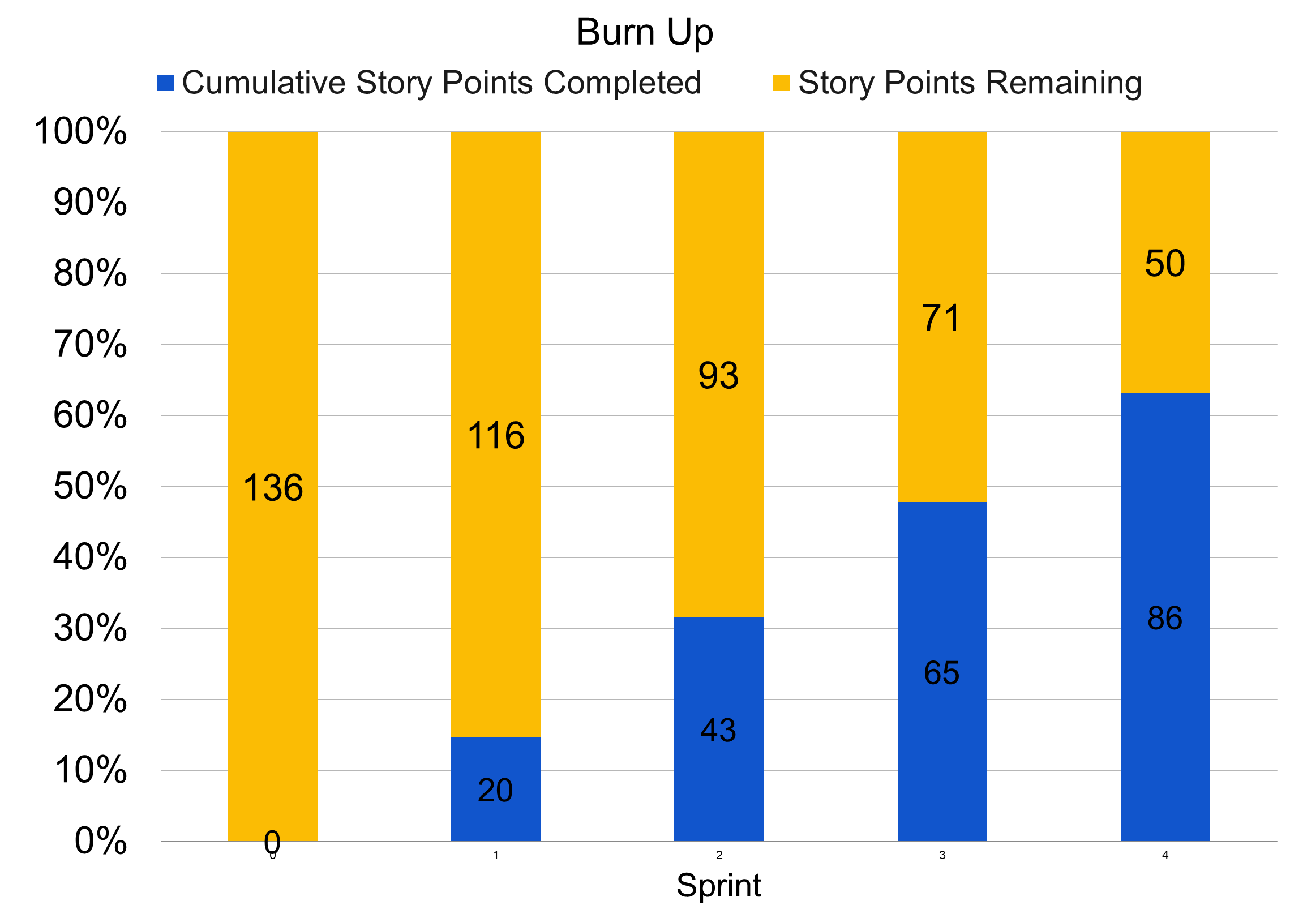
Sprint 4 Questions
What would the BURN DOWN chart look like for Sprints 1-4?
The Chart is on right
What would the BURN UP charts look like for Sprints 1-4?
The chart to the right.
What Risks did you identify in Sprint 4 and how do they affect the project? (Note: These would be your narrative findings)
The risks that could affect the project in sprint 4 including security and integration issues with Git and technical challenges, these risks affect ability to meet project objectives. The team should work to monitor and mitigate these risks .
What Theme or Name did you give to Sprint 4?
Security and Vulnerability Scaning.

Slide 7
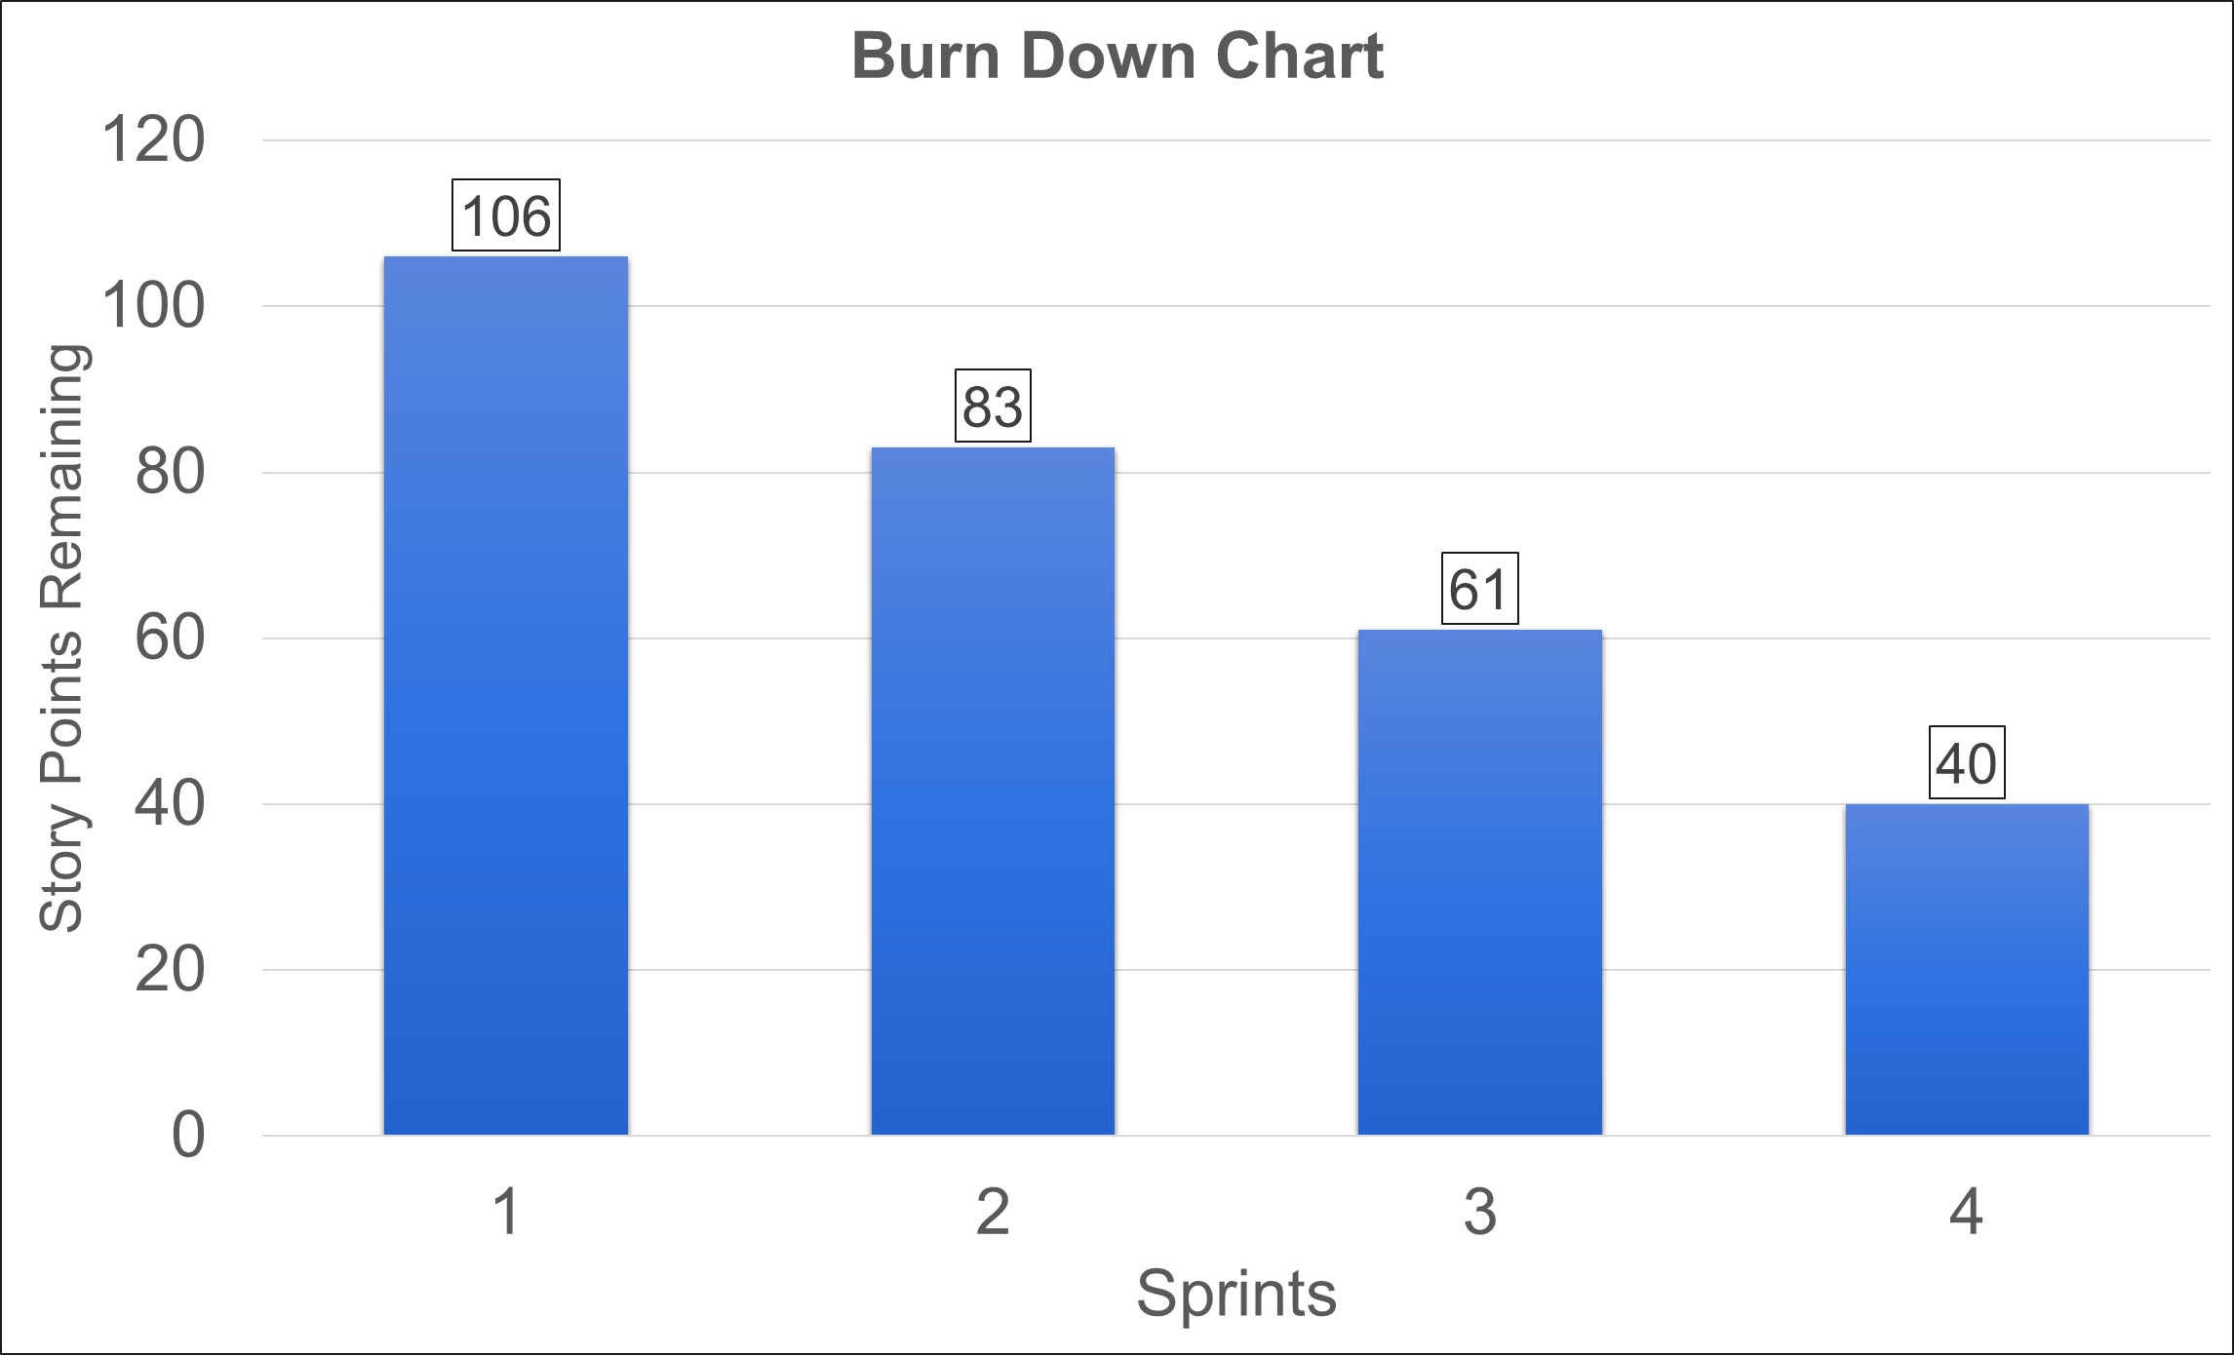
Team A
Sprint 4 Name
Security and Vulnerability Scanning
User Stories in Sprint 4
1. Story # 14 with 13 points
2. Story # 15 with 8 points
Total Sprint 4 Points: 21
Narrative: The team works to address any security risks by conducting website security scanning and providing access to the developer to Git to scan the code
Results They successfully completed the user stories that were committed to finish in sprint 4.
Learnings The team gets knowledge about Website security and code security.
Risks: All risks in this sprint were about security: the website security and the code security that affect customers information.
SPRINT 4 DEMO of Working Product

Slide 8
Agile Communication
Project
Sprint 5

Slide 9
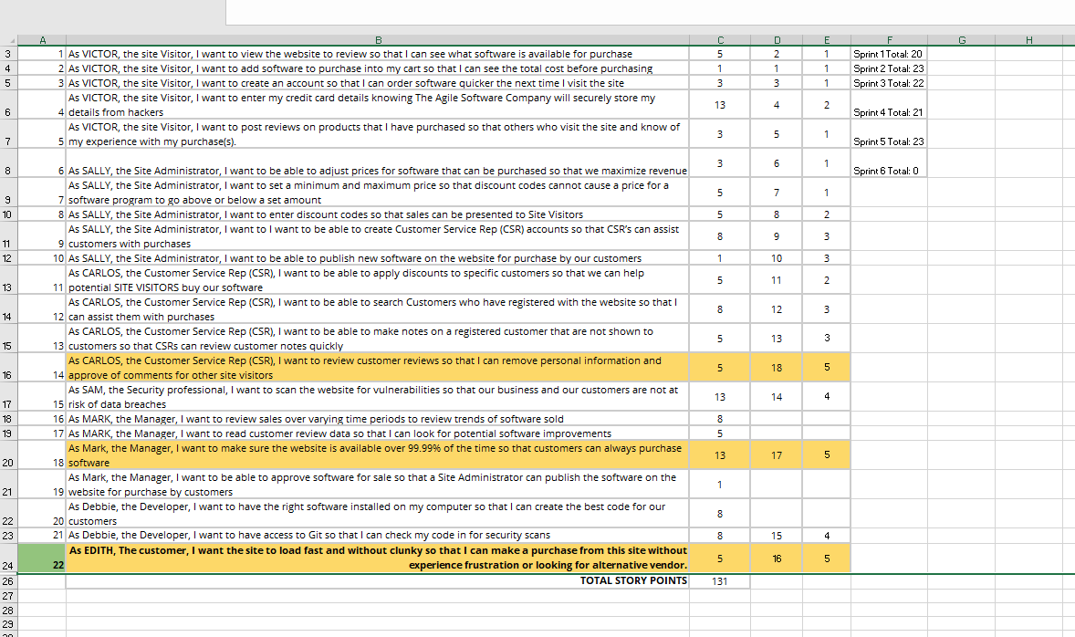
Place User Stories Table for Sprint 5 Here

Slide 10
Sprint 5 Questions
What would the BURN DOWN chart look like for Sprints 1-5?
The chart is placed to the right.
What would the BURN UP charts look like for Sprints 1-5?
The chart is placed to the right.
What Risks did you identify in Sprint 5 and how do they affect the project? (Note: These would be your narrative findings)
The identified risk in this sprint is not being able to deliver all the user stories by the end of the sprint due to the challenges and unexpected adjustments in the backlog.
How confident are you in delivering all of the user stories by the end of Sprint 6? Justify your answer.
Based on the velocity of our team is 23 story points. Our team can deliver all the requirements of this sprint but we need to take into account any unprojected challenge that may affect our ability to complete the work.

Slide 11
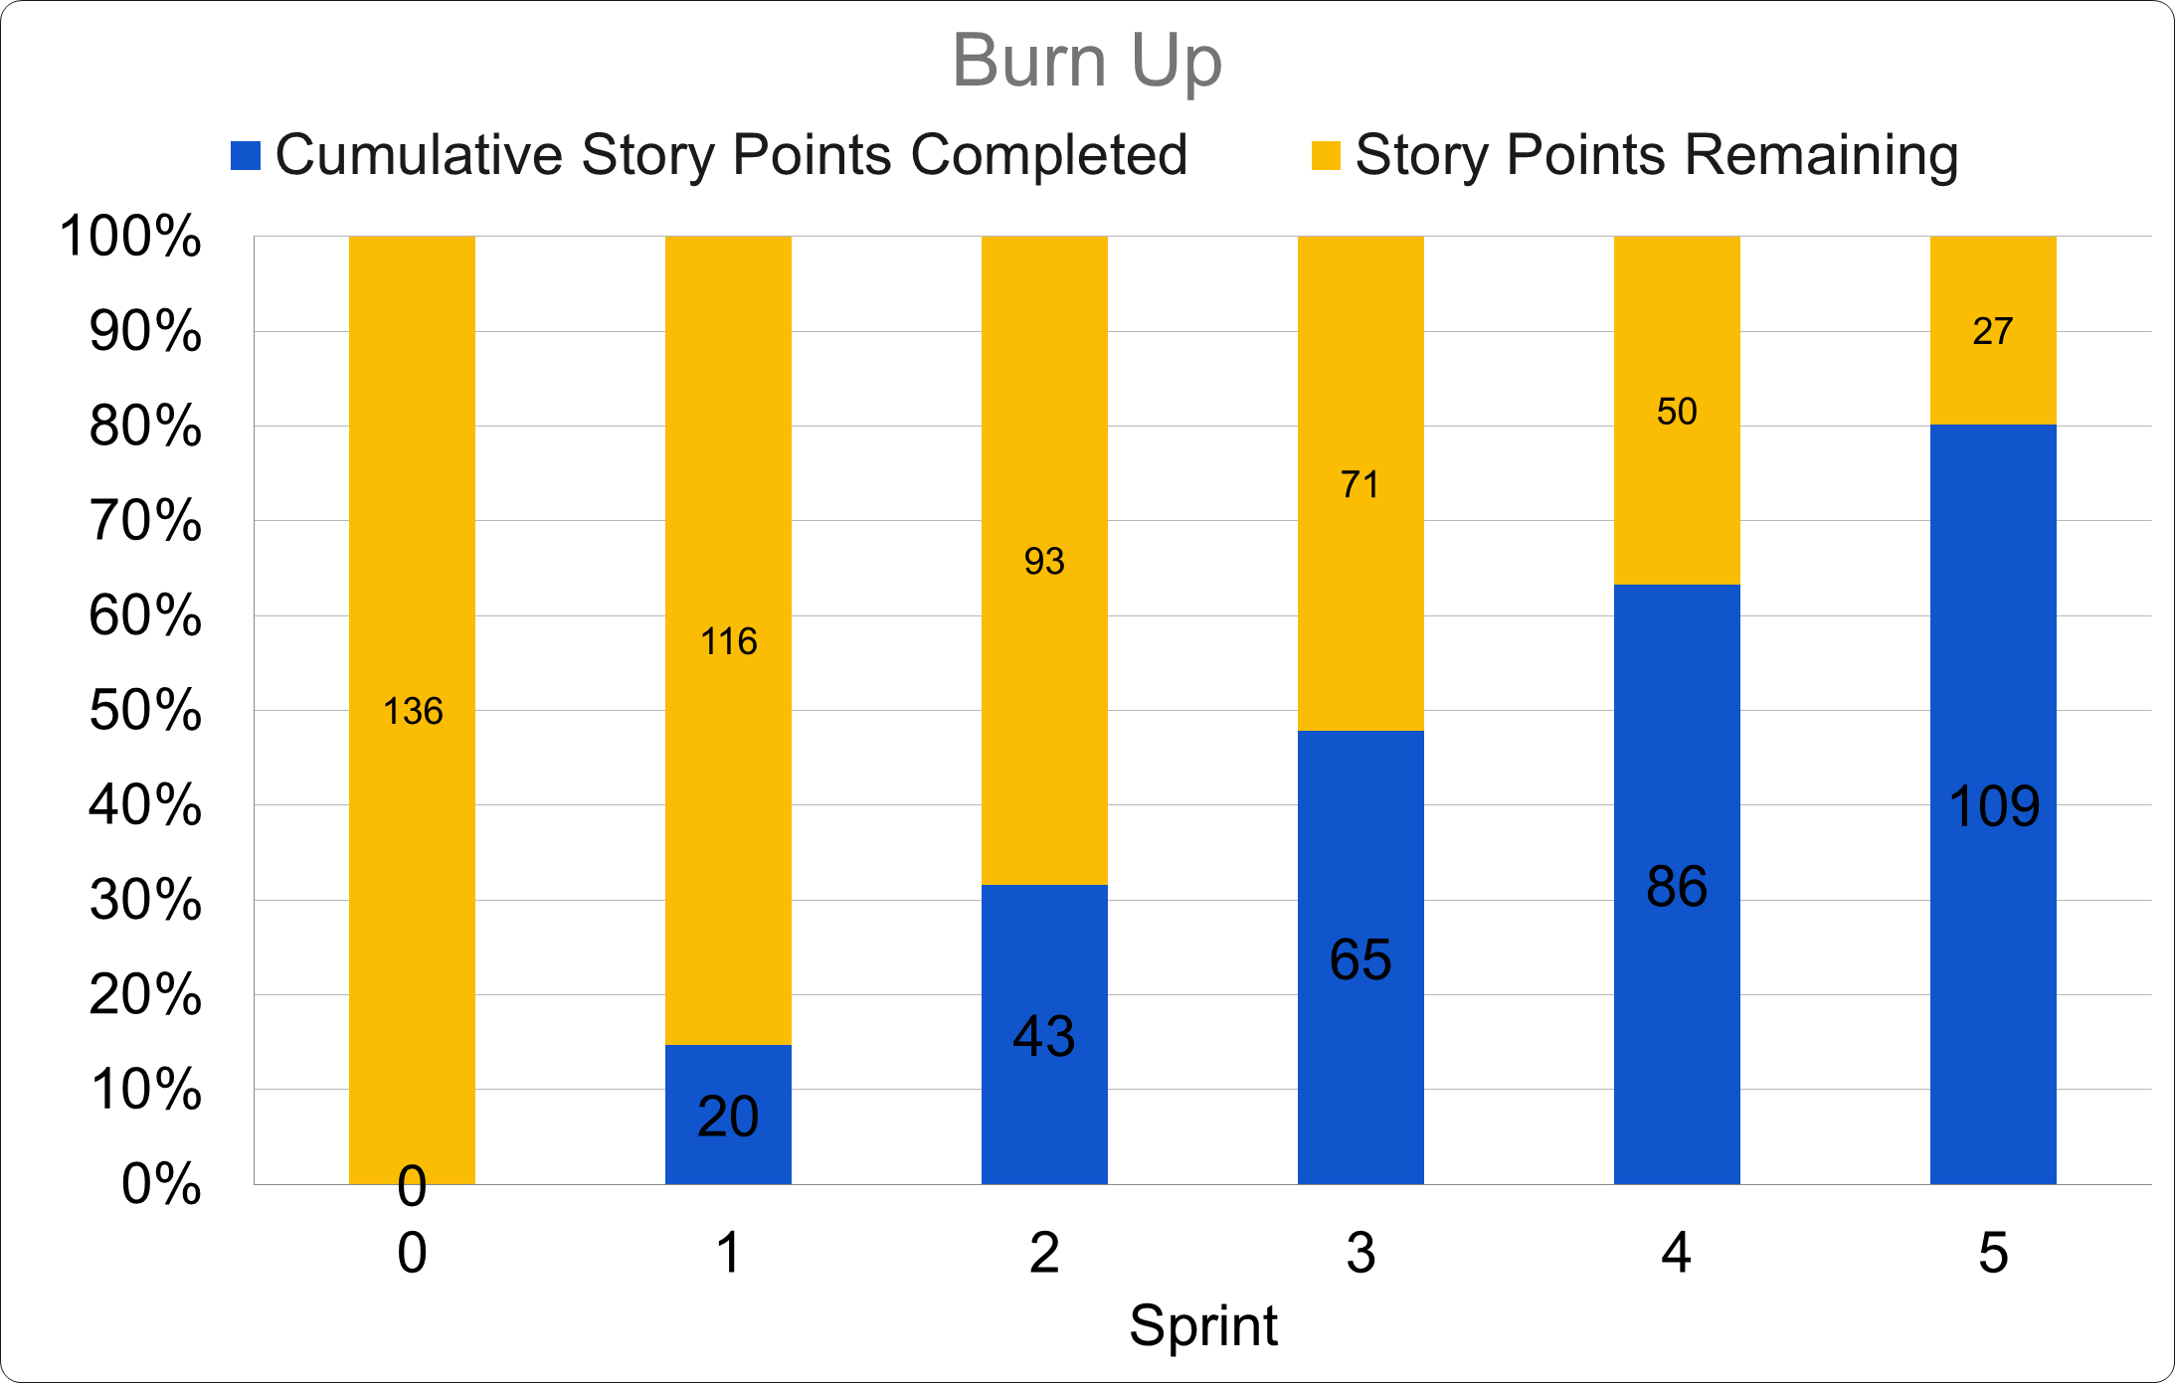
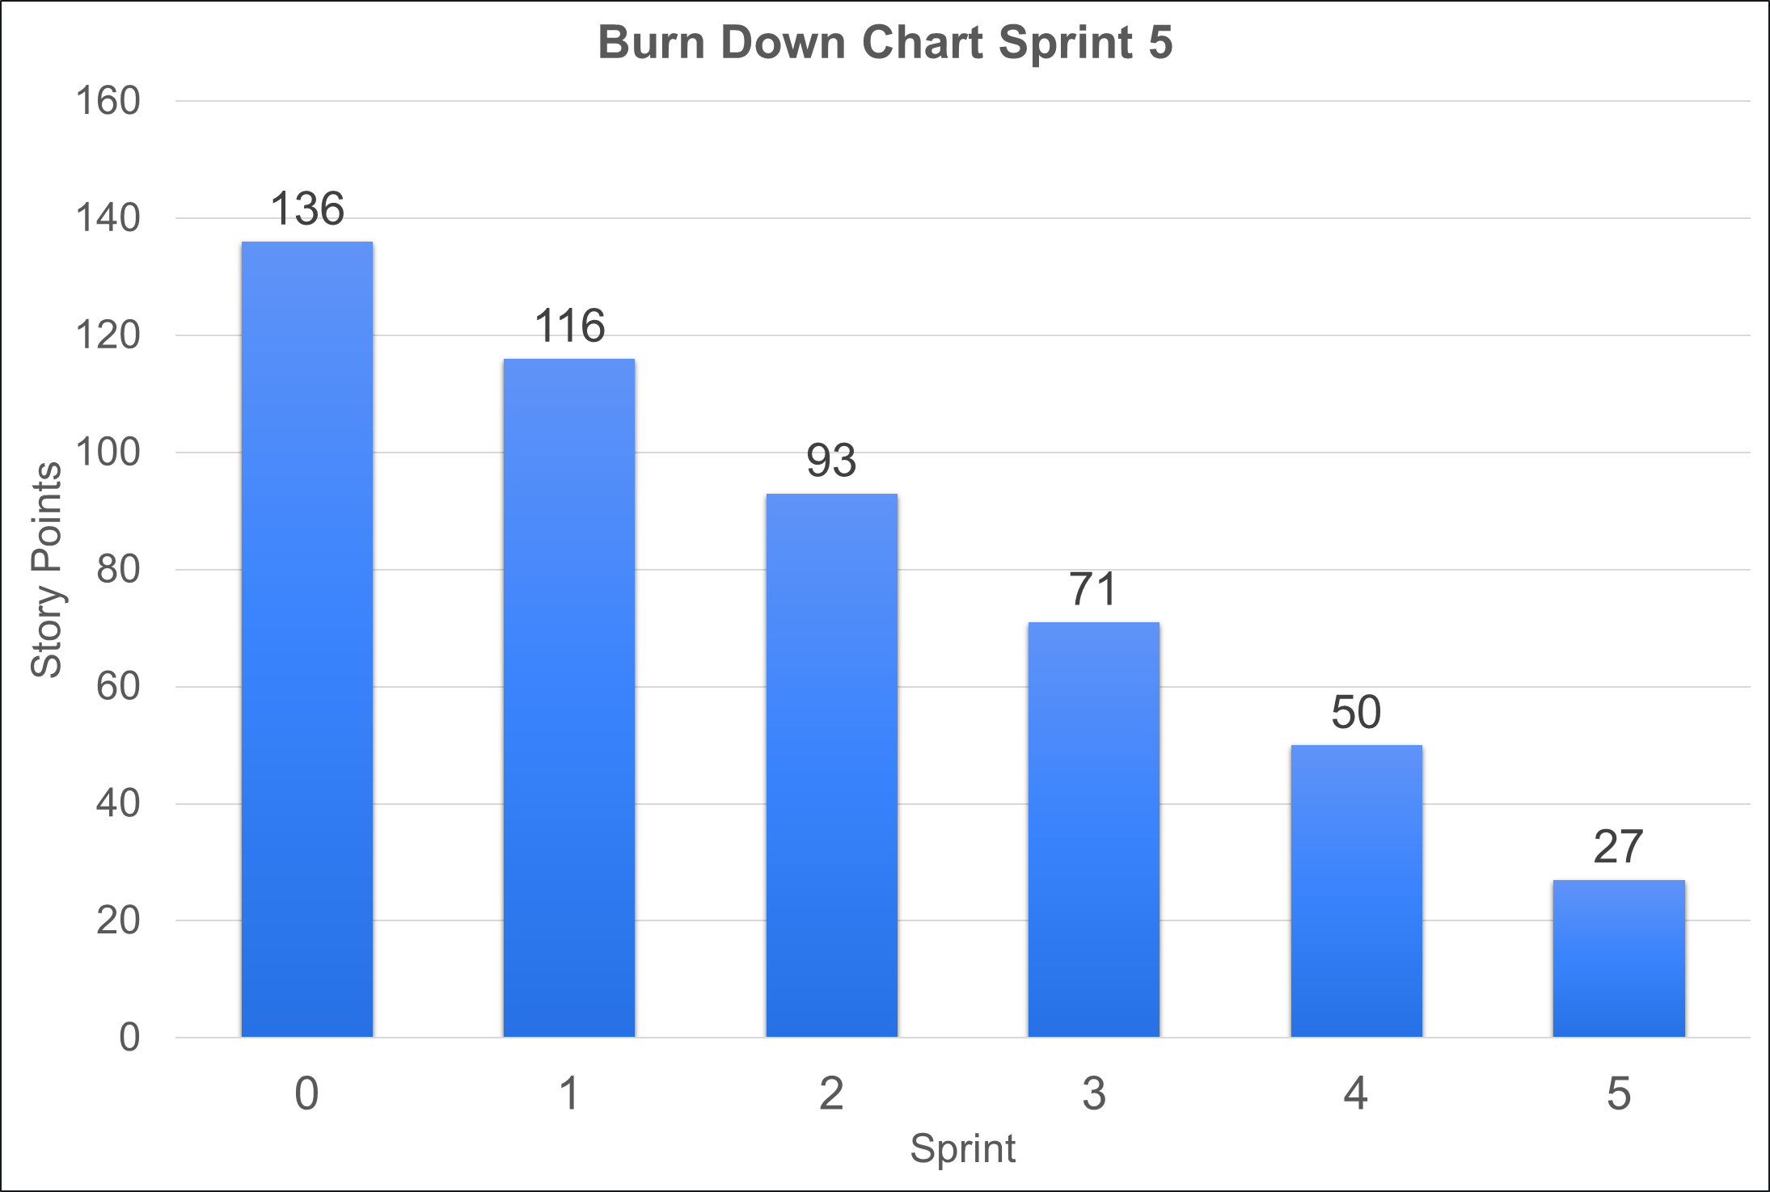
Team A
Sprint 5 Name
Improve user Experience.
User Stories in Sprint 5
1. Story # 16 with 5 points
2. Story # 17 with 13 points
3. Story # 18 with 5 points
Total Sprint 5 Points: 23
Narrative: The Team worked on addressing the customer feedback about the website function, and implement new features for customer reviews.
Results: The team successfully implement the customer need by improving the website speed and responsiveness and implementing new features for customer reviews.
Learnings: the importance of getting customer feedback early in the development process and working with costumer as an Agile manifesto.
Risks: Not able to address all customer feedback but the team managed to address the more important feedback.
SPRINT 5 DEMO of Working Product

Slide 12
Agile Communication
Project
Sprint 6

Slide 13
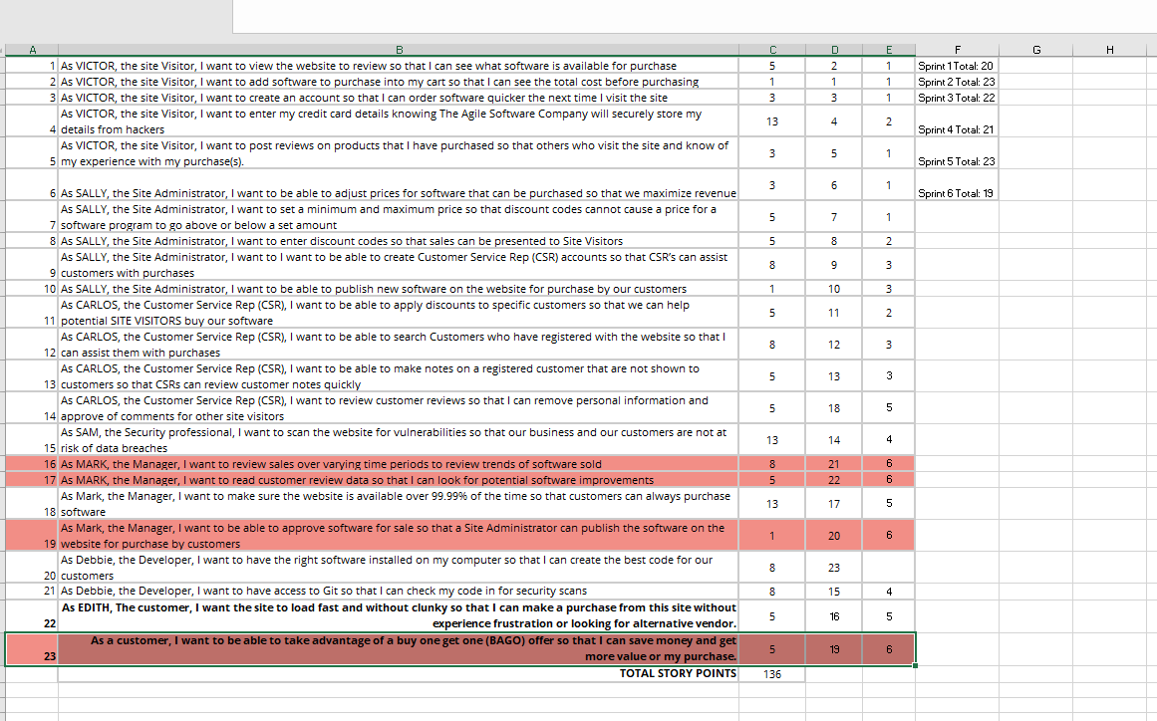
Place User Stories Table for Sprint 6 Here

Slide 14
What would the BURN DOWN chart look like for Sprints 1-6?
The chart to the right
What would the BURN UP charts look like for Sprints 1-6?
The chart to the right
Was the Team able to complete all the work in the backlog or did you have to adjust what could be delivered? How would you tell this to Management and justify your answer?
Based on the velocity of the previous sprints and the remaining story point in the backlog the team will be able to complete all the work. But do the pandemic cause a reprioritizing of the backlog and the addition of new story. The team was able to reprioritize the backlog and complete the required work.

Slide 15
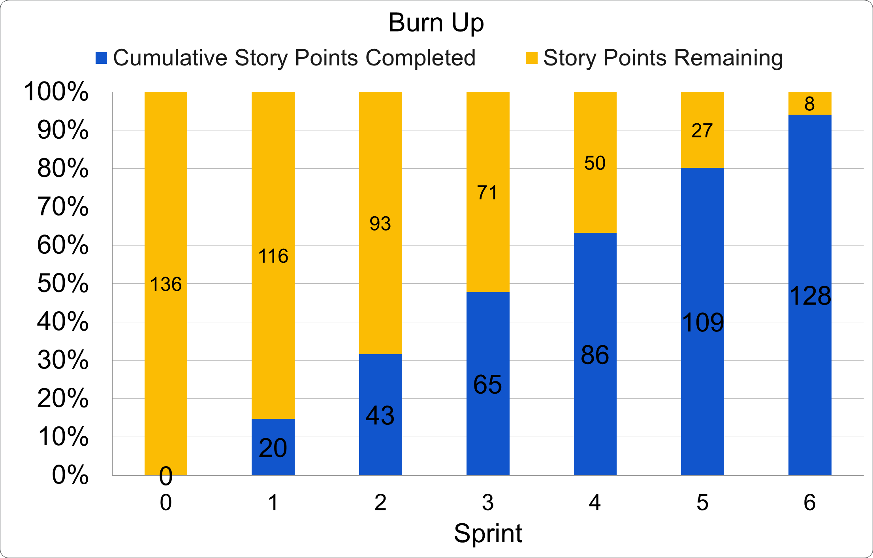
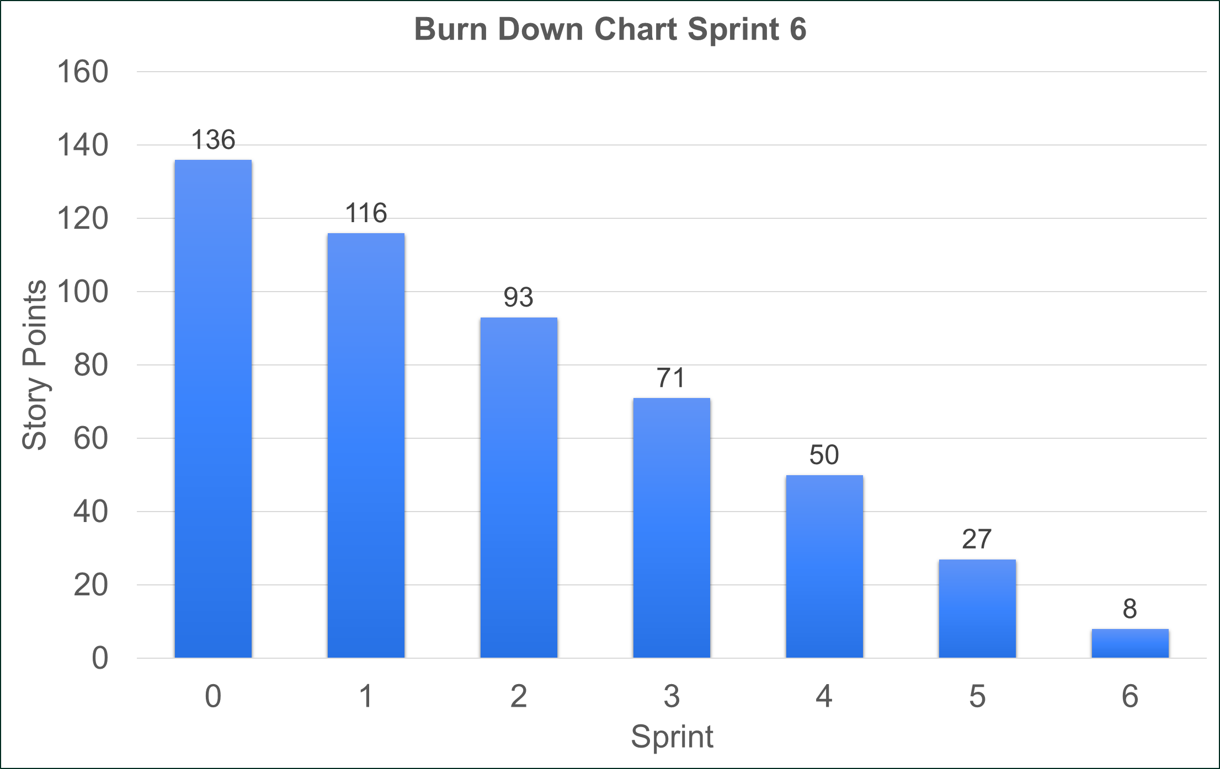
Team A
Sprint 6 Name
“Sales Analysis”
User Stories in Sprint 6
1. Story # 19 with 5 points
2. Story # 20 with 1 point
3. Story # 21 with 5 points
4. Story # 22 with 8 points
Total Sprint 6 Points: 19
Narrative: The manager wants to have the ability to read and review customer feedback to conduct some sales analysis and also to see any area for improvement. also wants to have the ability to approve software for sale so that the Site Administrator can publish the software on the website for customer purchases. Additionally, a BOGO offer will be implemented for e qual or lower-priced items to enhance customer value.
Results: A- the manager is able to review and approve software for sale, allowing the Site Administrator to publish software for customer purchase. The BOGO offer was also implemented,
Learnings: The implementation of BOGO offers increase customer satisfaction and gained experience in managing software approvals.
Risks: including implementation and the possibility of incorrect software approvals, and customer dissatisfaction.
SPRINT 6 DEMO of Working Product

Slide 16
BVIR for Management Questions
Which charts would you want to include in the BVIR that Management would need and why?
Move the Orange boxes to the correct column below
[Provide Justification goes here]
Included
Not included
Burn Down Charts
Burn Up Charts
Committed vs. Delivered Chart
Story Point Cost per Team

Slide 17
Creating the BVIR for Management
Questions to answer before you start the BVIR
What would tell Management if they want to know the details about actual stories?
[Select from the choices below]
"While I understand that you want to get into individual stories and know all the details, we would prefer that Management spends your valuable time guiding and influencing the Roadmap and direction of the project and leave the story delivery to the Teams you have empowered."
Absolutely, let's get into the details!
No, that is none of your business
Which of the above did you choose (1,2,3) and why?
I choose one because it manifests the Agile Manifesto, and it clearly underlines the role of the top management in an Agile environment.

Slide 18
Creating the BVIR for Management
Questions to answer before you start the BVIR
Is it project considered a failure because backlog items still remain? Explain.
The remaining story points in the backlog do not necessarily mean the project failed. In Agile the team works on prioritizing the backlog stories in the order of their importance, based on the product vision, stakeholder need, and customer feedback. The team’s main goal is to complete the most important backlog items and deliver value to customers and stakeholders. The team works on continuing to improve the product based on customer feedback.

Slide 19
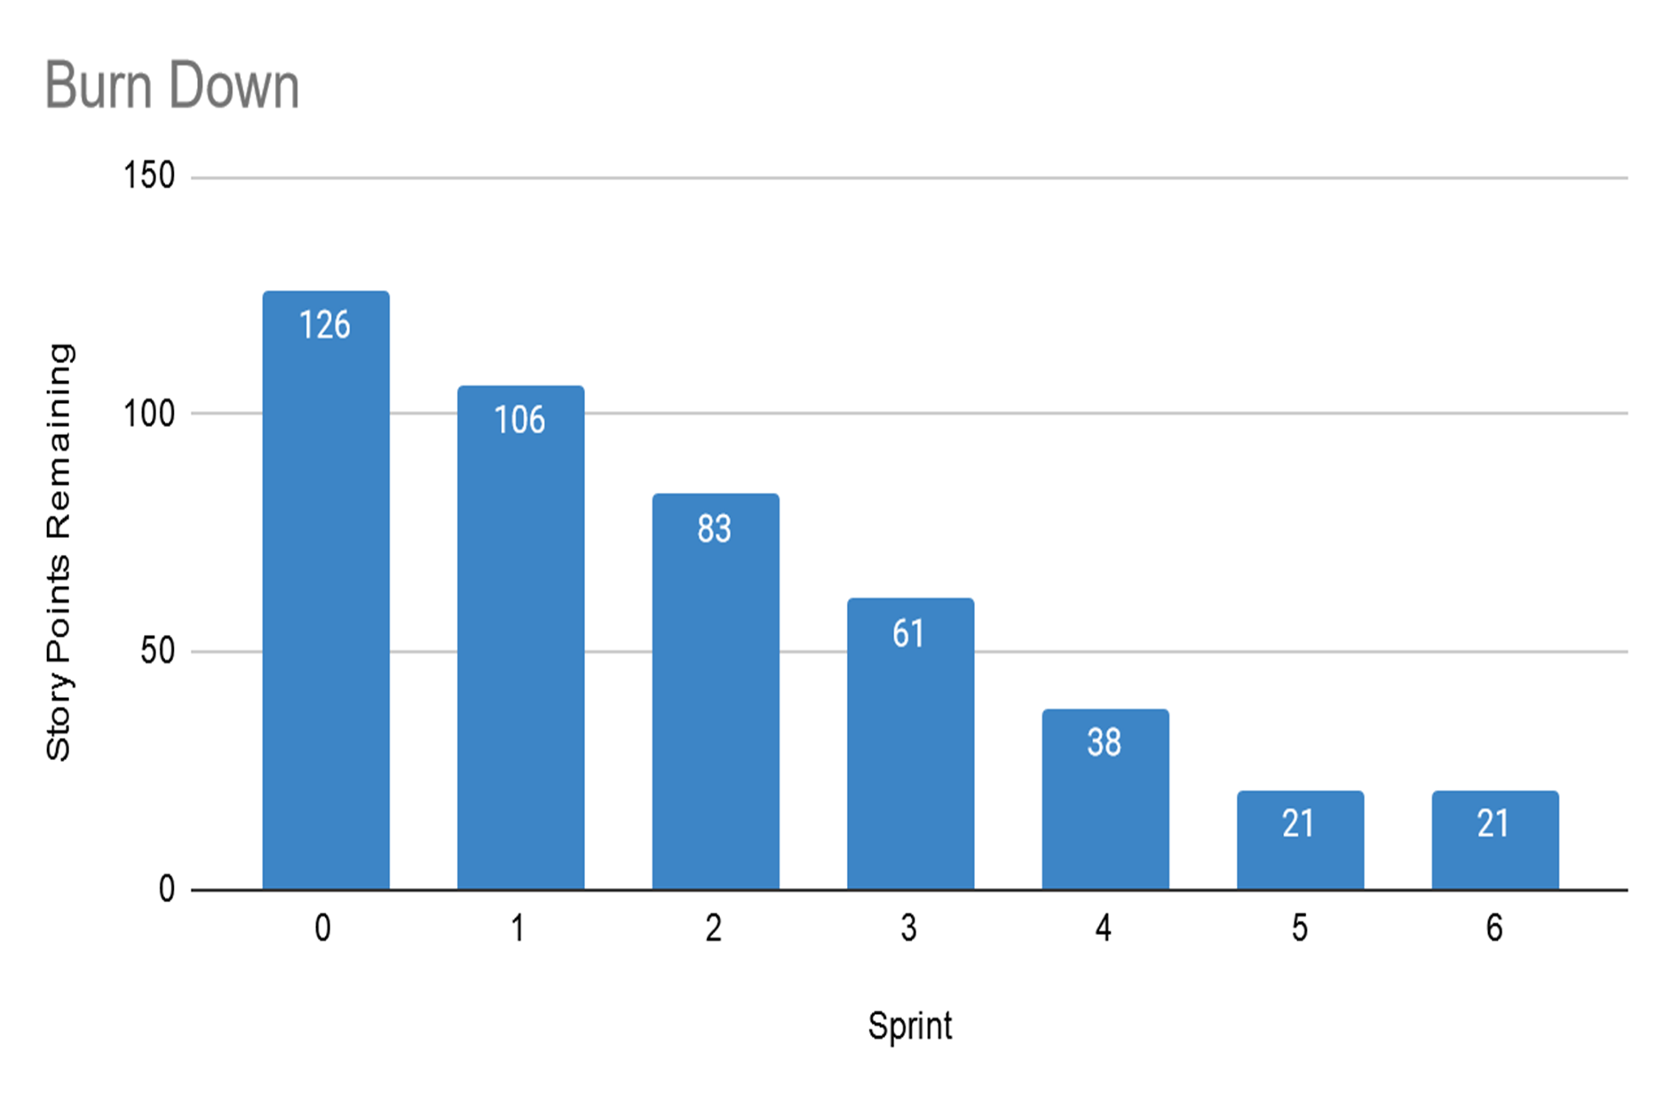

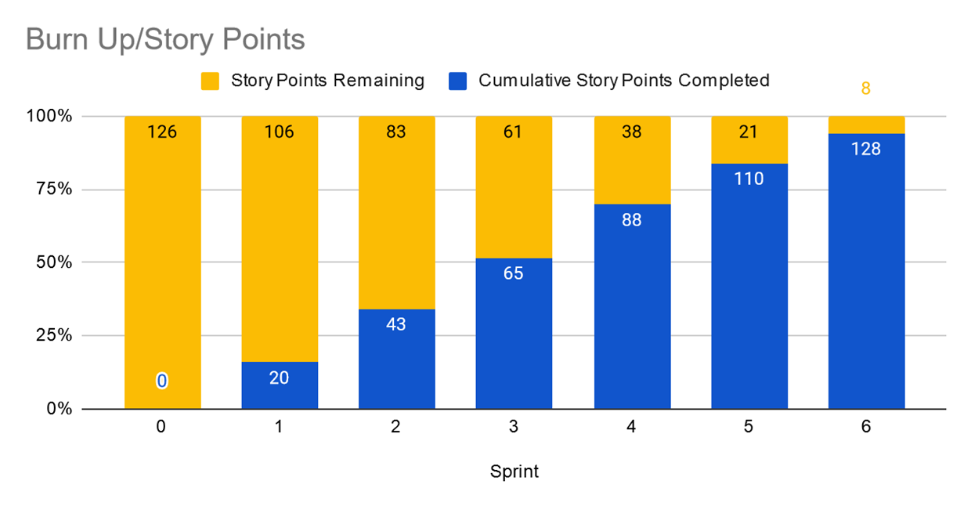

BVIR for Management
[Use this slide to create your BVIR. We have not provided a template for this, you get to decide what it looks like using the information from the previous slide]
Team
A

Slide 20
BVIR for Management
[Now that you have created your BVIR for management, you need to create a video or written narrative explaining the MVP delivery status.
Good morning, everyone, hope everyone doing well. In this meeting, I will present the current project’s status to you. Our vision is to provide our customers with a satisfying website t get our software. Our team did an excellent and professional job of achieving this mission. You'll see the sprint Burn Up and Burn Down charts for 1-6 Sprints that articulate the completed and remaining story points in every sprint. However, we’ve faced some challenges over the sprints, but our team overcame all the challenges, for example in sprint 4 we worked on a serious security risk urgently by applying the Agile manifesto we adapted the change and completed sprint 4. In sprint 5, the customer pointed out significant issues that were related to the website performance (load, speed) that could lead to losing the customers, but we fixed the problems immediately. Finally, in sprint 6, due to the pandemic, we prioritized the BOGO promo but unfortunately, we have left with 8 stories which means the project is still not completed and we need to the 7th sprint. Thank you.

Slide 21
Questions from Management (Using Videos would be great!)
Instructions:
Watch the videos in the classroom.
Record your videos or provide your answers below. Remember to justify your answer.
[Video # 1 Answer] The concern of the MVP not being perfect the purpose is to release a functional product with minimum features that articulate the main purpose of our product to test the market and collect real-life customer feedback this allows us to improve our product through iterative sprints. Our main goal is to continuously improve our product based on real-life customer feedback.
[Video # 2 Answer] As per Agile Manifesto Responding to change over following a plan, means being flexible and adaptable to any change. While we do have a plan but we faced unpredictable challenges and we had to do some adjustments to ensure we were still delivering value to customers. We prioritized the critical features of the customer and address the urgent risks we faced.
[Video # 3 Answer] Forcing our team with working 24hr or overtime for some hours a day leads to burnout and decreases the team’s productivity and the quality of their deliverable. We have to consider the feasibility and sustainability of our team. We need to be Agile and ‘walk the walk’
[Video # 4 Answer] : Based on the current backlog the remaining is only 8 story points and based on the velocity of the previous sprint we can end the work in just one sprint within the reasonable time frame, So I would recommend adding the 7th sprint to the project But we need some analytics to see the impact of this decision over resources and project.

